Slide 1

Recitation 10 /////

Slide 2
Announcements
HW05 due this Thursday (10/28)
HW06 released this Friday and due next Thursday (11/04)
Exam 3 next Friday (11/05)

Slide 3
Topic Trivia
(True/False) The following is a valid way of initializing an ArrayList of Strings:
(True/False) You can resize an ArrayList with the resize() method.
If we had a method that sorted an array using selection sort and searched it using binary search, what would be the time complexity of this method?
(True/False)You can instantiate a generic type e.g saying T someObj = new T();
What is the big O of Bubble Sort?
(True/False) Big O measures the efficiency of the code, not the runtime.

Slide 4
Topic Trivia
(True/False) The following is a valid way of initializing an ArrayList of Strings:
(True/False) You can resize an ArrayList with the resize() method.
If we had a method that sorted an array using selection sort and searched it using binary search, what would be the time complexity of this method?
(True/False)You can instantiate a generic type e.g saying T someObj = new T();
What is the big O of Bubble Sort?
(True/False) Big O measures the efficiency of the code, not the runtime.
true
false
O(n²)
false
O(n²)
true

Slide 5
Topics List
ArrayList
Generics - basics
Asymptotics/Big O
Searching
Sorting

Slide 6
ArrayList – What are they?
ArrayList is a class in Java which acts as a List
These elements are ordered and able to be indexed
Unlike arrays, they are resizable
Must import java.util.ArrayList to use
Cannot hold primitive types (how can we get around this?).
To instantiate an ArrayList:
ArrayList stuff = new ArrayList();

Slide 7
ArrayList – Useful methods
Some methods we can use:
get (int index)
add(Object element)
add(int index, Object element)
remove(int index)
remove(Object target)
contains(Object o)
indexOf(Object o)
size()
More can be found in the Java API

Slide 8
ArrayList vs Arrays
Dynamic size (resizable)
Can only hold objects, no primitive types
Access elements through the get() method
Size can be checked through the size()method
Requires you to import java.util.ArrayList;
Static size (fixed length)
Can hold primitive data types as well as objects
Access elements using []
Size can be checked through the .length attribute.
Does not need to be imported

Slide 9
ArrayList – Type Issue
The way we have currently defined ArrayLists they can hold any Object type.
This may cause many casting errors
One solution is to create separate ArrayLists for each type Ex:IntegerArrayList, StringArrayList…
This is not optimal, what if there were a better solution??

Slide 10
Generics - Basics
Generics allow for parameterization of types.
Ex. ArrayList <String> alist = new ArrayList<>();
You can use any letter to represent your generic type, but we typically use <T> and <E> for “type” and “element”
Generics allow you to detect errors at compile time instead of runtime.

Slide 11
Asymptotics / Big O
Measures efficiency of code, NOT the runtime of the code.
Describes the rate at which the number of operations increases as the input size grows.
O(n²) means that for every n new inputs we perform approximately n² more operations
The big O of a program is the efficiency of the code for the worst possible case.
O(n² + n) => O(n²)
O(1) < O(log n) < O(n) < O(n log n) < O(n^{k}) < O(k^{n}) < n!

Slide 12
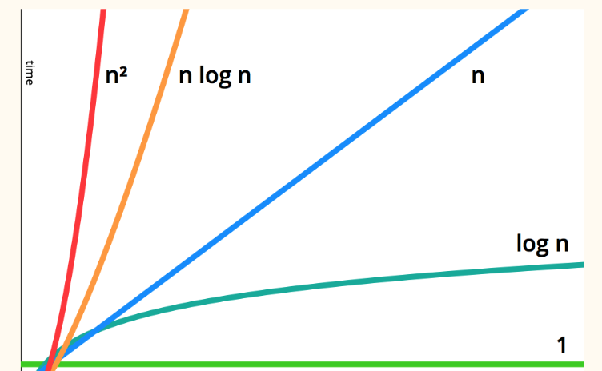
Asymptotics / Big O

Slide 13
Asymptotics / Big O
We can determine the Big O of code by looking at how many times it iterates over all elements in some input.
For calculations, we approximate by dropping constants
n - 1 operations -> O(n-1) = O(n)
an operation twice for every element -> O(2n) = O(n)
exactly 4 operations independent of input size -> O(4) = O(1)

Slide 14
Big O Example
Imagine the following sorting algorithms:
Algo 1: O(n log n)
Algo 2: O(n²)
For a thousand elements:
Algo 2 takes ~100 times longer to run
For a hundred thousand elements:
Algo 2 takes ~6000 times longer to run
For a billion elements:
Algo 2 takes ~33,500,000 times longer to run

Slide 15
Linear Search
Linear search - iterate through the list and check every element
O(n): 1 billion elements -> (at most) 1 billion operations
Linear search is O(n) as in the worst case where the element to be found is at the end it has to go over every element before finding the required element.

Slide 16
Binary Search
If an array is sorted, we can use binary search which is a much faster method to find an element.
Steps in a binary search
Check whether the middle element is the required element, if it is then the element is found.
If the middle element is less than required element, since the array is sorted, the required element must lie to the right of the middle
If the middle element is greater, the required element must lie to the left of the middle
Repeat this process till element is found.

Slide 17
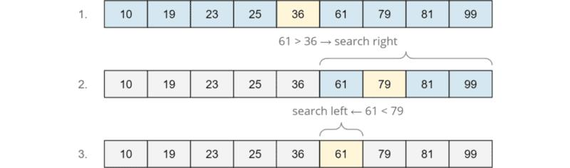
Binary Search
Since at each iteration the array is cut into half, binary search is O(log n)
1 billion elements -> (at most) 30 operations
Here we are searching for 61

Slide 18
Sorting
Sorting is extremely useful to organize data and make data retrieval much faster. (Think binary search)
The three sorting algorithms that we will cover are:
Bubble sort
Selection sort
Insertion sort

Slide 19
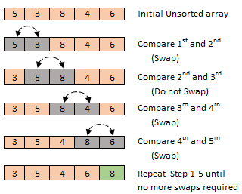
Bubble sort
Repeatedly swap adjacent, out-of-order elements through the array, moving (bubbling) the largest element to its proper location
Optimized to stop after a pass where no swaps are made
For an array of size n, bubble sort runs through the array swapping elements at most n times and hence is O(n²)

Slide 20
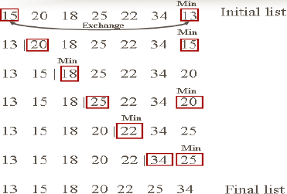
Selection sort
‘Select’ the smallest/largest to the right of the current position and swap that element with the current position.
After k iterations, the first k elements are sorted and in their final positions
Selection sort is also O(n²)

Slide 21
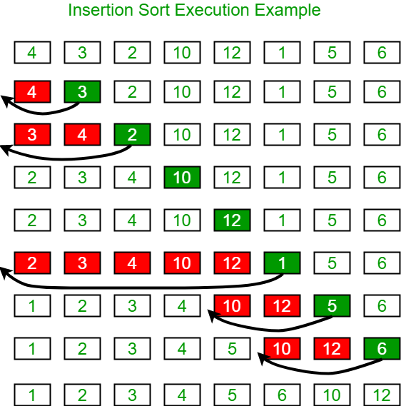
Insertion Sort
Works by dividing the array into 2 subarrays, a sorted part and an unsorted part, and “inserting” the elements from the unsorted part one by one into their correct locations.
After k iterations, the first (k+1) elements are sorted but not necessarily in their final positions
Insertion sort is also O(n²)

Slide 22
Coding Activity
TAs will now go through a live coding activity!

